Slide 1
CS225/226-Switching Theory
Touch-Free Automatic Hand Sanitizer Dispenser
Aradhya Gupta (1901CS72)

Slide 2
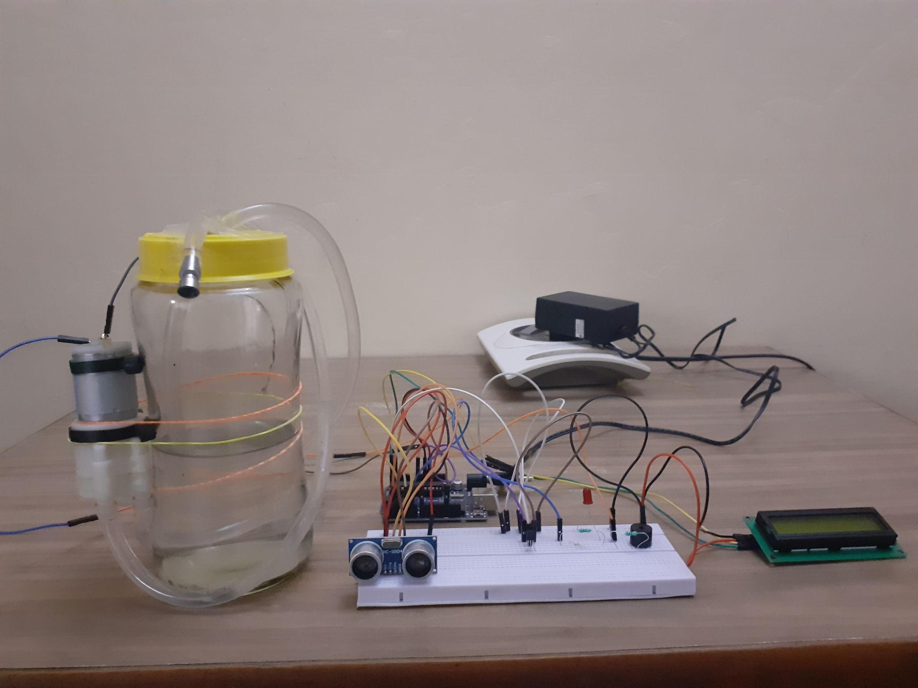
AIM OF THE PROJECT
To implement an automatic hand sanitizer dispenser using an Arduino Uno board along with various other electronics components like DC pump and ultrasonic sensor, thus to familiarize with and understand their working principles and applications.
The world is facing a tough time. COVID-19 has proved to be one of the deadliest pandemics humanity has ever faced. The need for touch free hand sanitizers has increased tenfold.

Slide 3
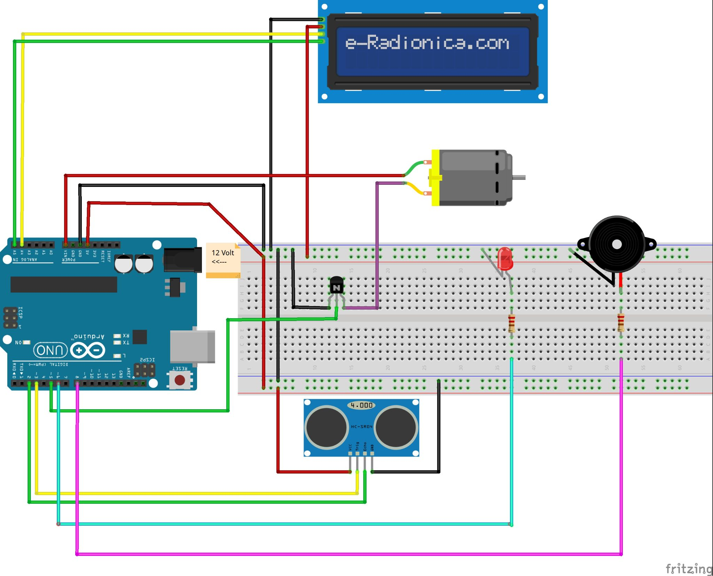
COMPONENTS USED
Arduino Uno
HC-SR04 Ultrasonic Sensor
12 volt DC Pump
JHD162A LCD display with I2C module
BC547B npn transistor
Buzzer
12 volt DC adaptor
Red LED
Resistors (220 ohm)
Jumper-wires, breadboard
Hand Sanitizer Container

Slide 4
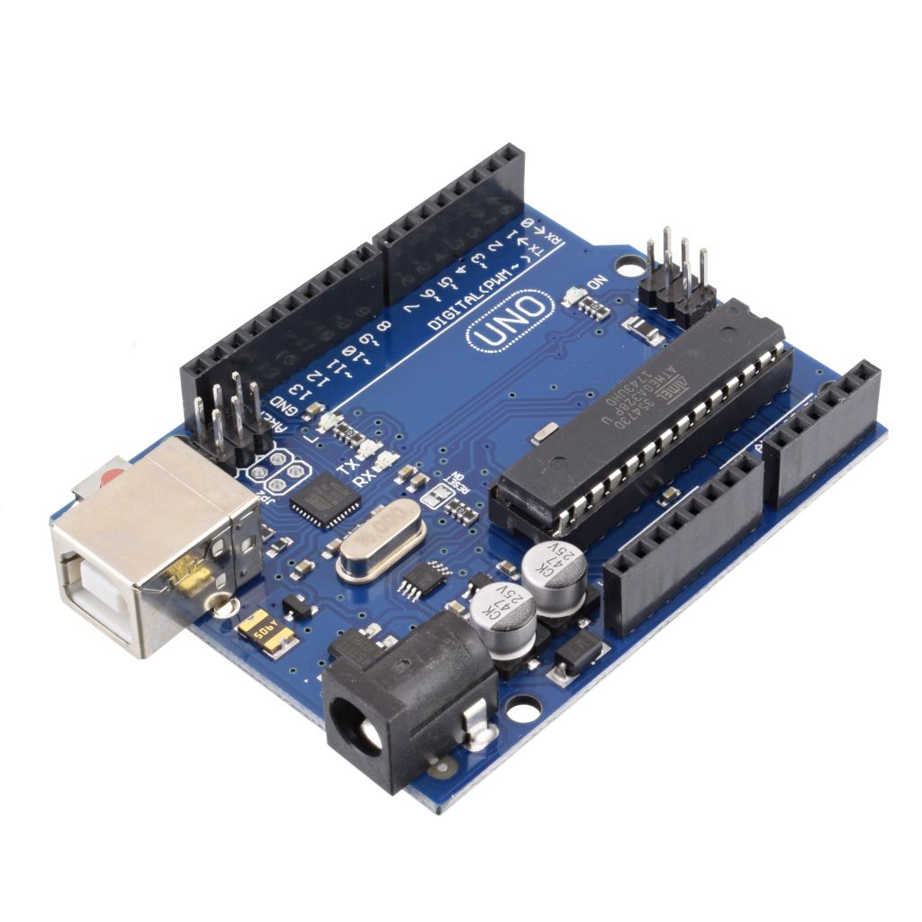
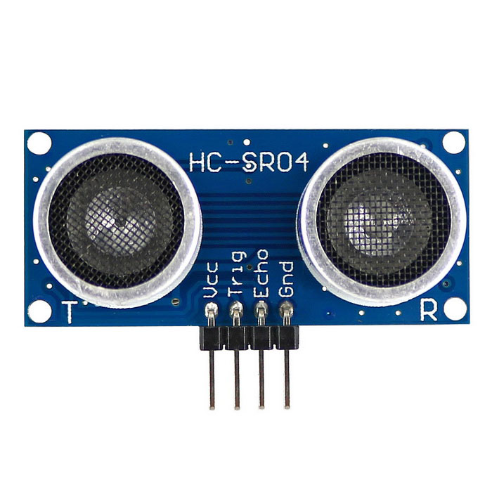
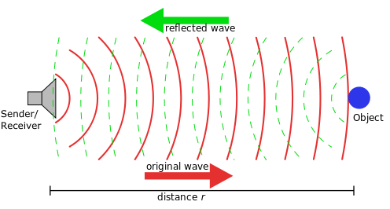
Arduino UNO
It is an open-source microcontroller board based on the Microchip ATmega328P microcontroller. The board is equipped with sets of digital and analog input/output (I/O) pins. It has 14 digital I/O pins, 6 analog I/O pins, and is programmable with the Arduino IDE.
HC-SR04 Ultrasonic Sensor
HC-SR04 Ultrasonic sensor is used to detect the presence of a hand. It is capable of transmitting and receiving ultrasonic sound waves out into the air and calculates the distance from the sensor to the obstacle by making use of the time required for the sound wave to reach back the sensor. It has 4 pins, ground, VCC, trig and echo. The ground and the VCC pins of the module need to be connected to the ground and the 5 volts pins on the Arduino Board respectively and the trig and echo pins to any digital I/O pin on the Arduino Board.

Slide 5
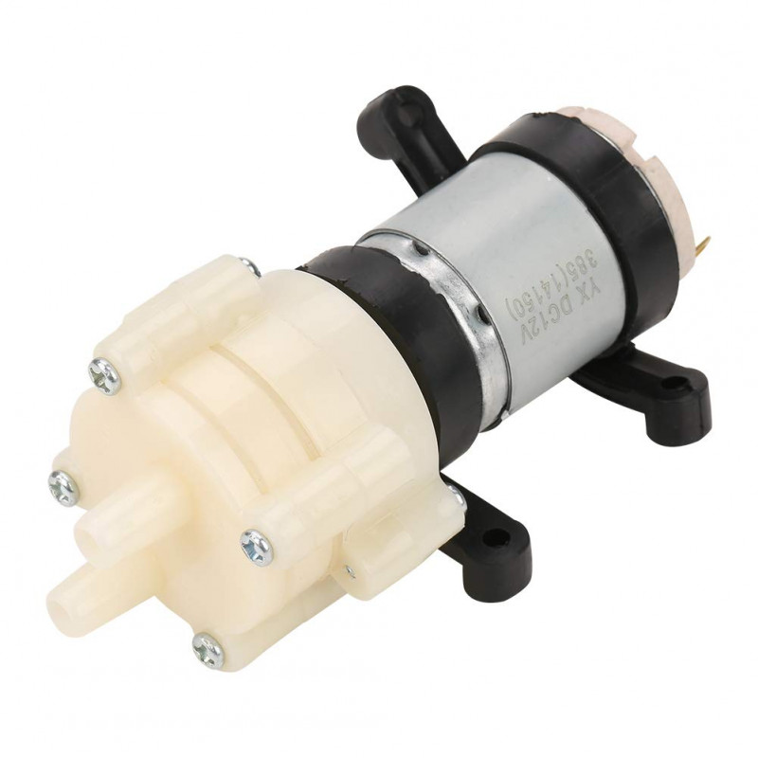
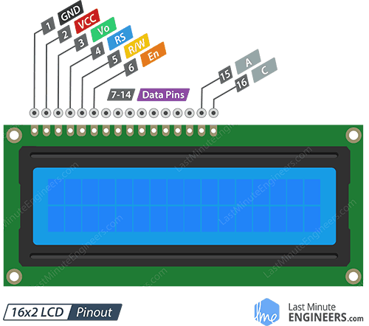
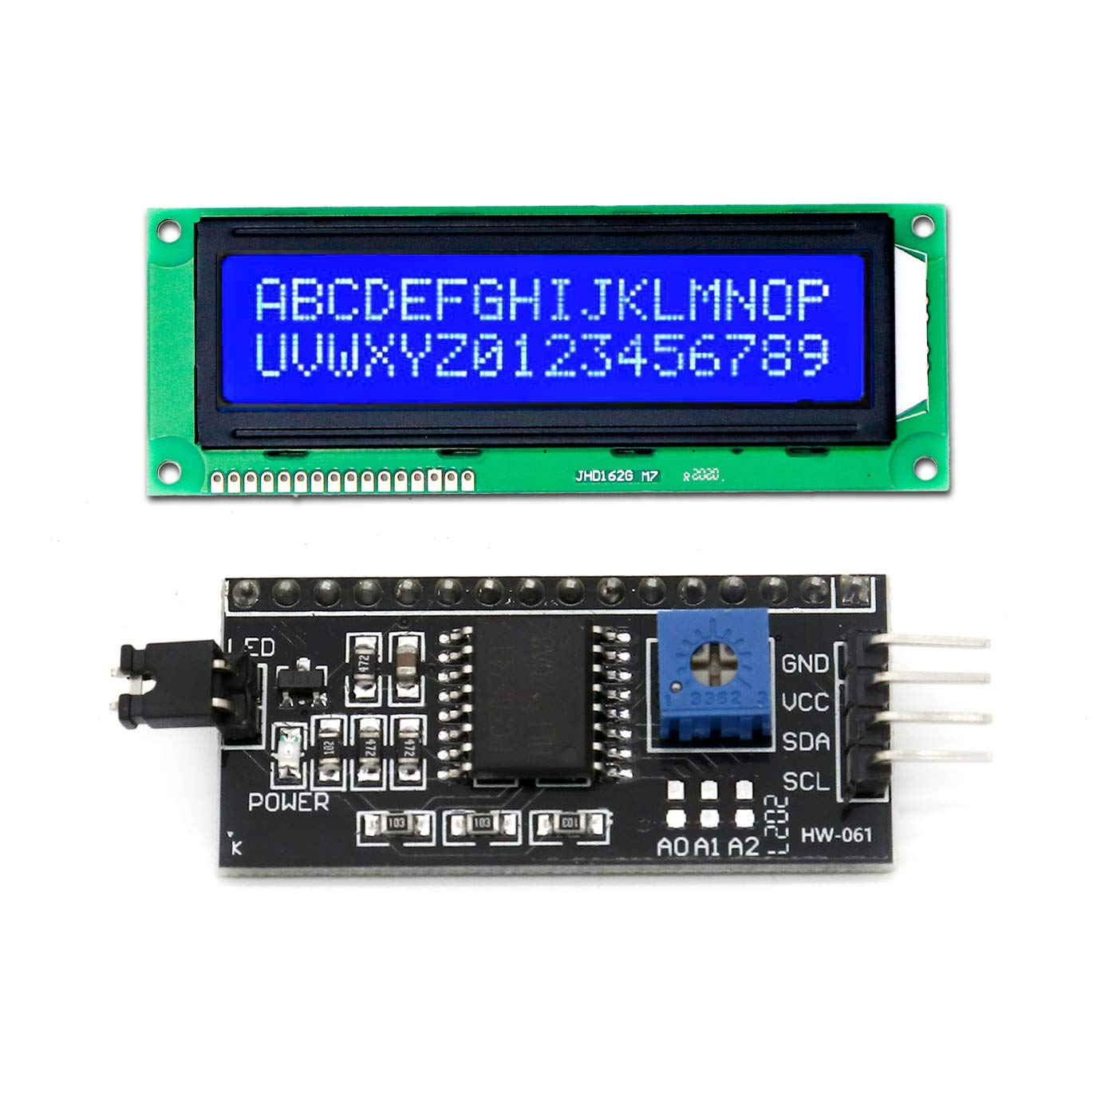
DC Pump
R385 6-12V DC Diaphragm Based Mini Aquarium Water Pump is an ideal non submersible pump for variety of liquid movement application. It has enough pressure to be used with nozzle to make spray system. The pump can handle heated liquids up to a temperature of 80°C and when suitably powered can suck water through the tube from up to 2m and pump water vertically for up to 3m.
16X2 LCD Display with I2C module
This display can show 2 lines of 16 characters each. It has 16 pins as shown in the adjacent diagram. Usually this display takes up 8 pins of arduino board thus leaving less pins for other functions. I2C module solves this issue by reducing the number of pins required from 8 to 4. It has 4 pins - GND (connected to ground pin of arduino), VCC (5 volt pin), SDA(analog pin A4 of arduino) and SCL (analog pin A5 of arduino).

Slide 6
How does it work ?
When a person brings his hand in 3 cm proximity to the ultrasonic sensor, the transistor pin (pin 5) gets triggered and current passes to the DC pump through the transistor which acts as as amplifier (converts 5 volt to 12 volt). The pump pushes the liquid from the container into and out of the tube. The number of uses is displayed on the LCD screen and as soon as the threshold for the number of uses is reached, the LED starts glowing and the buzzer turns on to indicate that the container needs to be refilled.

Slide 7
Source Code
//include libraries required for LCD display #include <Wire.h> #include <LiquidCrystal_I2C.h> //define arduino pins to be used #define echoPin 2 #define trigPin 3 #define transistorPin 5 #define ledPin 6 #define buzzerPin 8 //global variables long duration; // time taken by ultrasonic pulse to come back int distance; // distance of hand from ultrasonic sensor long number = 0; // number of times used const int threshold = 3; // maximum number of uses allowed before refill (set to 3 for ease of demonstration) // Set the LCD address to 0x27 for a 16 chars and 2 line display LiquidCrystal_I2C lcd(0x27, 16, 2);

Slide 8
//set the modes(input or output) of used pins void setup() { lcd.begin(); pinMode(buzzerPin, OUTPUT); pinMode(trigPin, OUTPUT); pinMode(echoPin, INPUT); pinMode(transistorPin, OUTPUT); pinMode(ledPin, OUTPUT); Serial.begin(9600); } void loop() { lcd.clear(); //calculate distance of hand from ultrasonic sensor digitalWrite(trigPin, LOW); delayMicroseconds(2); digitalWrite(trigPin, HIGH); delayMicroseconds(10); digitalWrite(trigPin, LOW); duration = pulseIn(echoPin, HIGH); //in micro secs

Slide 9
distance = duration * 0.034 / 2; //speed of sound=340 m/sec Serial.print(" Dist: "); Serial.print(distance); Serial.print(" cm Cntr: "); Serial.print(number); Serial.print(" "); if(number<threshold){ lcd.print("Number: "); lcd.print(number); } if(number>=threshold){ digitalWrite(ledPin, HIGH); //turn the LED on lcd.clear(); lcd.print("REFILL"); tone(buzzerPin, 2000); //buzzer emits sound of 2kHz frequency delay(2000); noTone(buzzerPin); Serial.println("LED on means 3 uses completed!"); }

Slide 10
else if (distance<=3){ //3 cm number++; digitalWrite(transistorPin, HIGH); //turn the DC pump on Serial.print("Pump On--"); delay(150); digitalWrite(transistorPin, LOW); Serial.println("--Pump OFF"); delay(2000); } else{ digitalWrite(transistorPin, LOW); Serial.println("--Pump OFF"); } delay(50); }

Slide 11
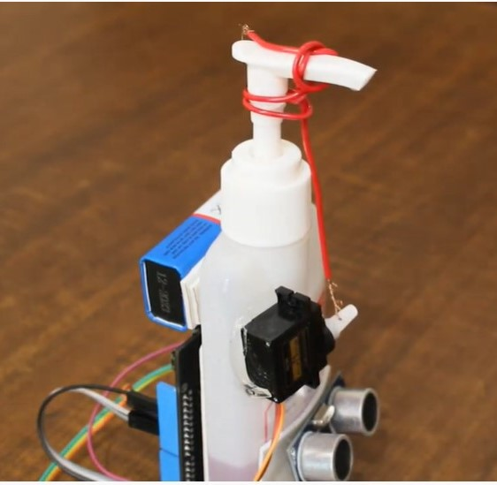
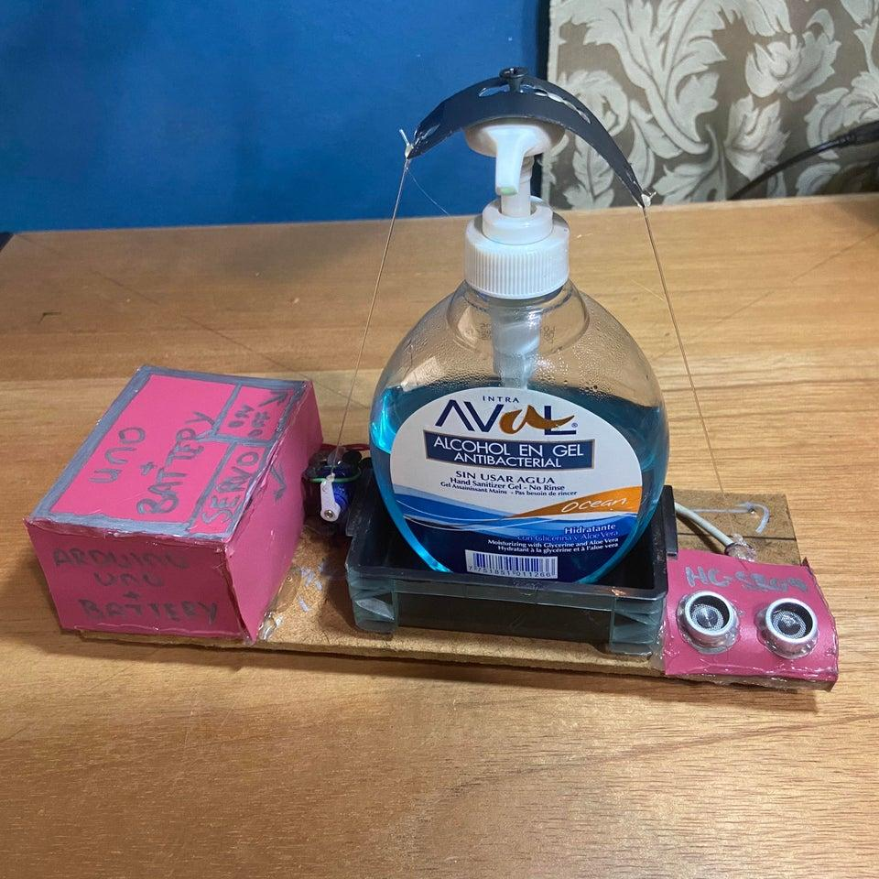
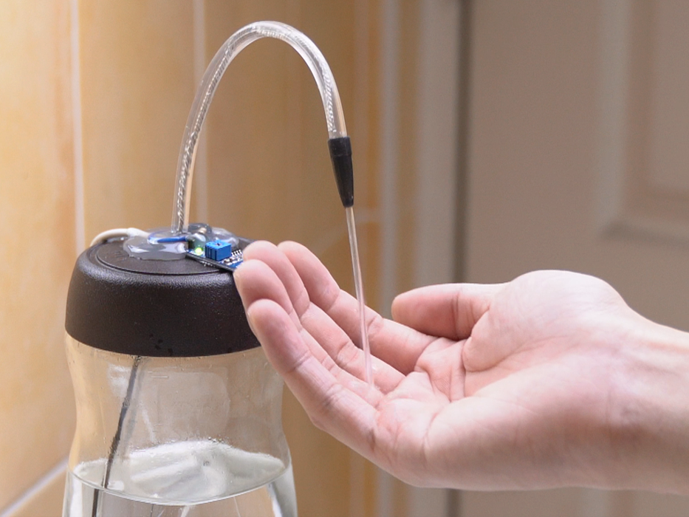
References and Other Implementations

Slide 12
Thank You

